Slide 1
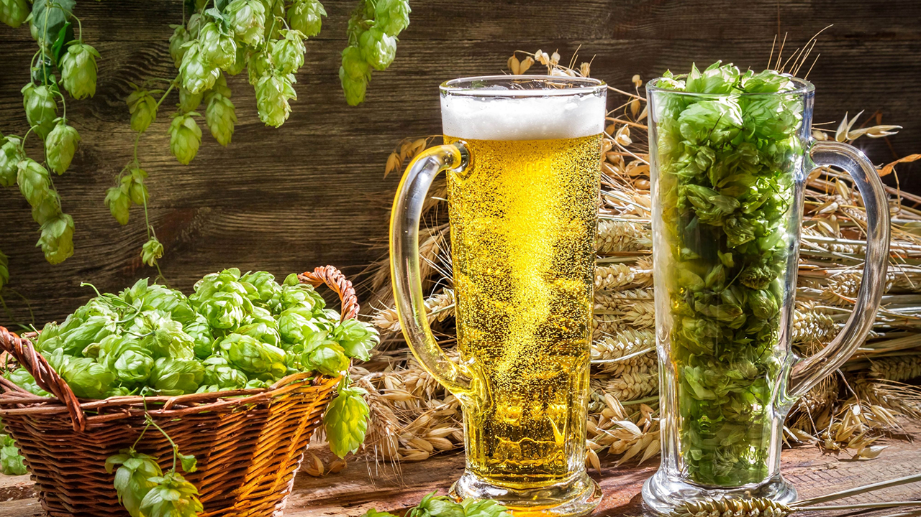
Beer
Jacob Gipson
Tavin Weeda

Slide 2
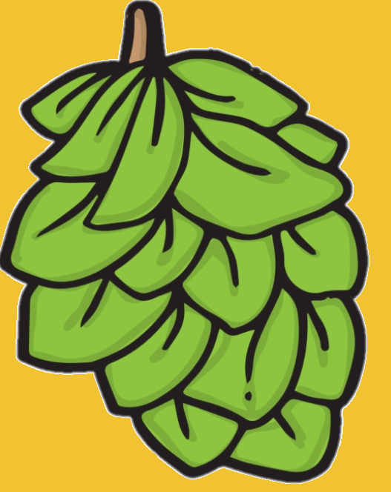
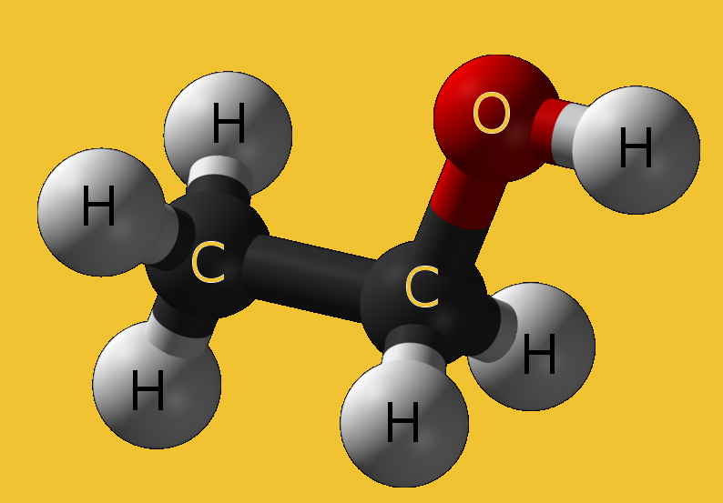
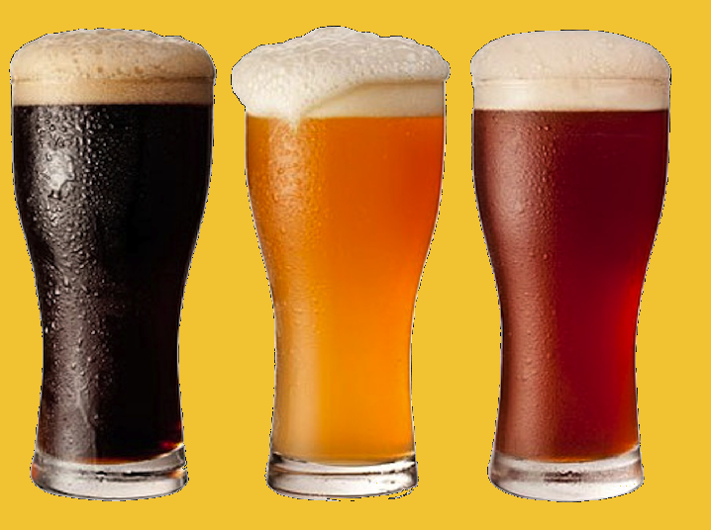
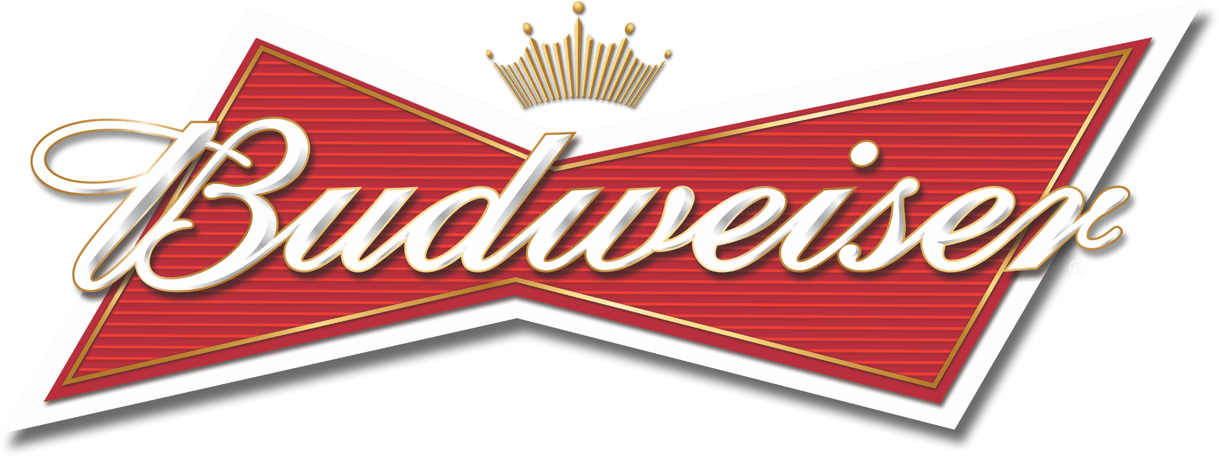
Addressing Missing Values
IBU: 1005
ABV: 62
Style: 5

Slide 3
Addressing Missing Values
Missing
IBU and ABV
Beers Missing Style
3 were not actual beers
Replaced missing IBU and ABV with the mean IBU and ABV for each style
2 were found online and input

Slide 4
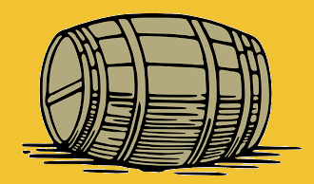
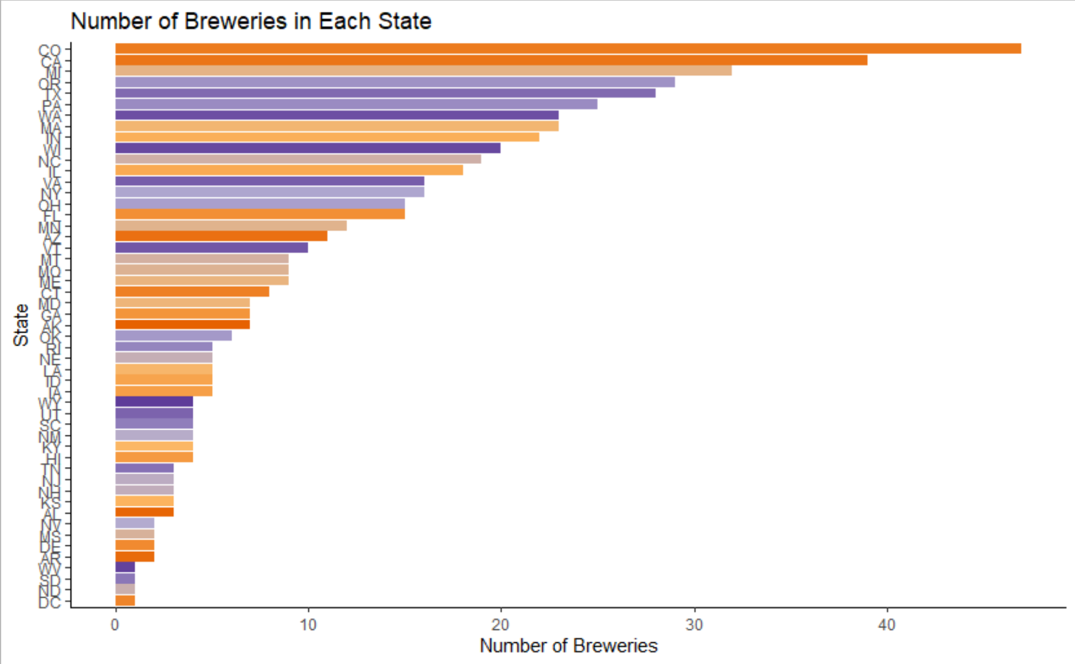
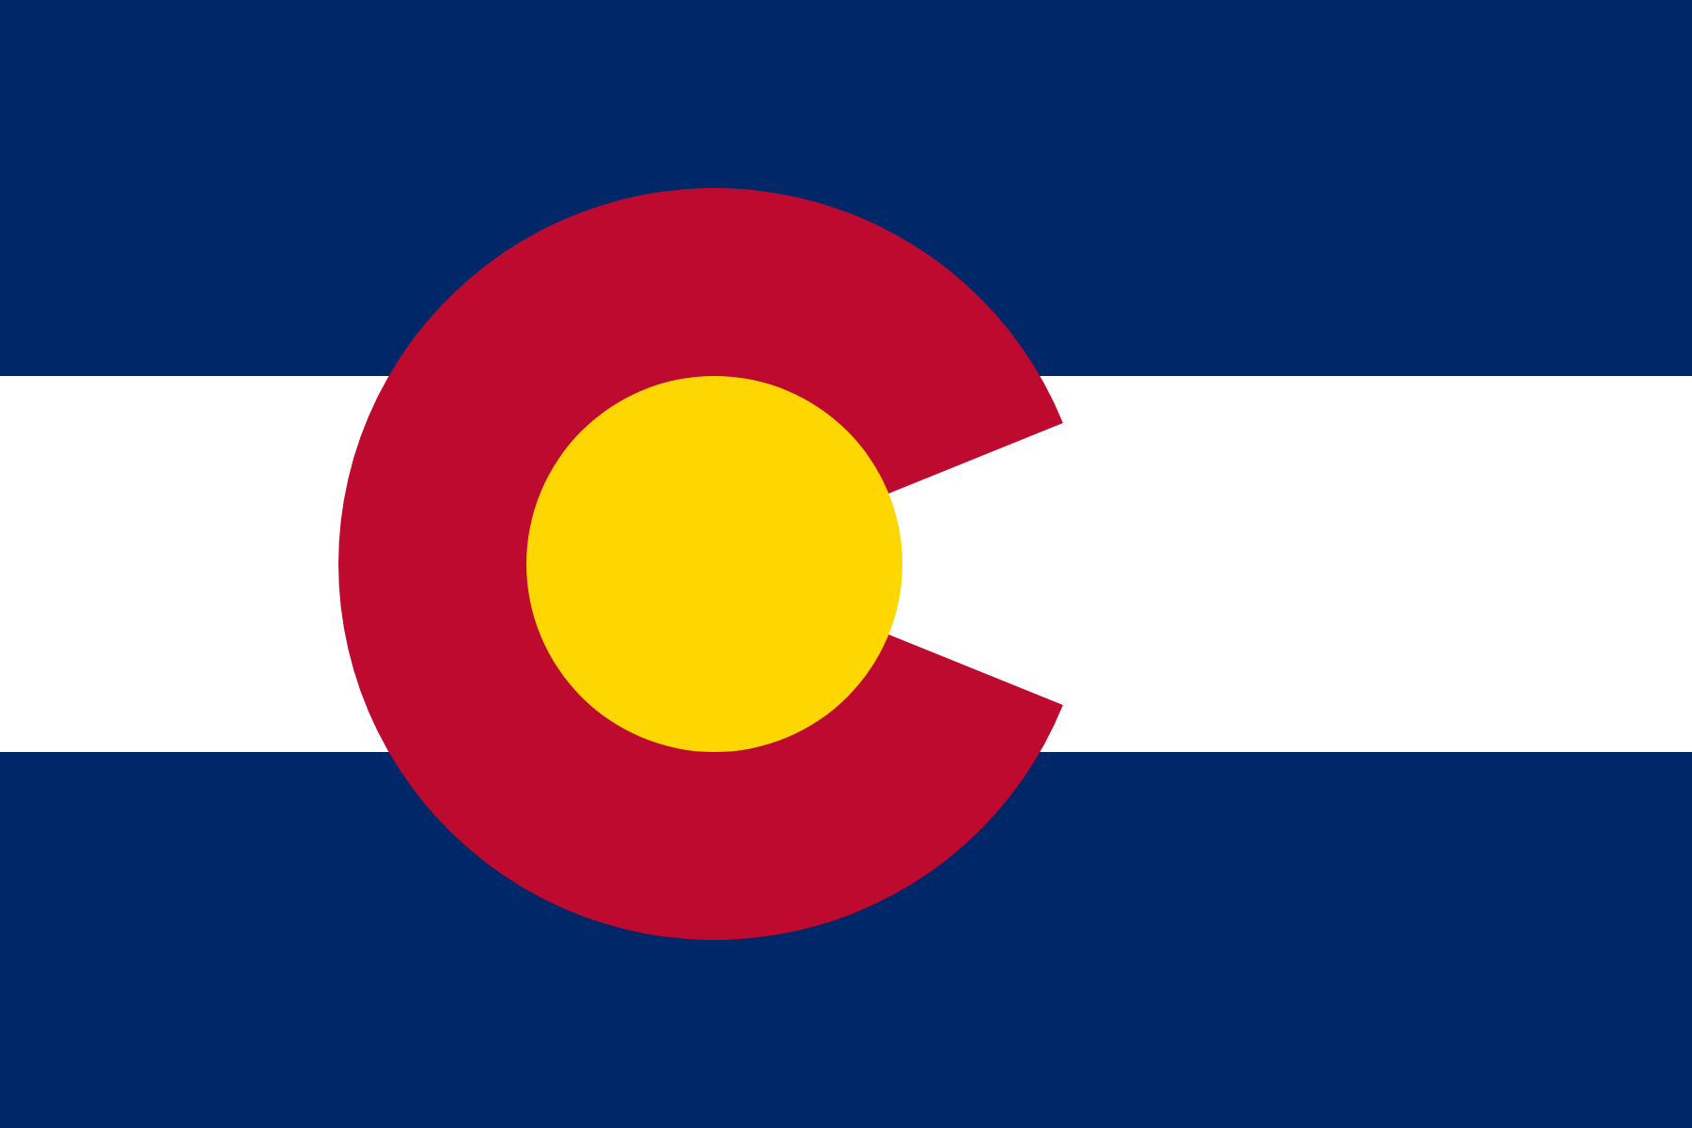
Breweries
47 Breweries
in Colorado

Slide 5
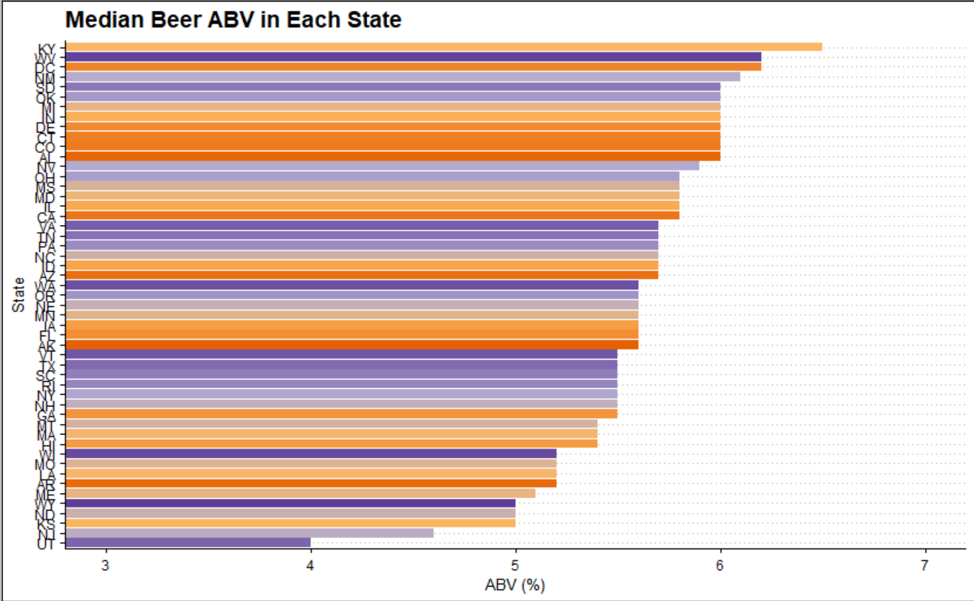
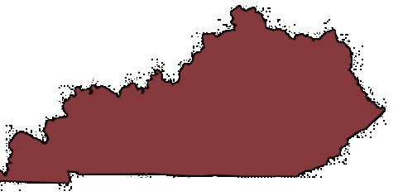
ABV
Kentucky median beer ABV 6.5%

Slide 6
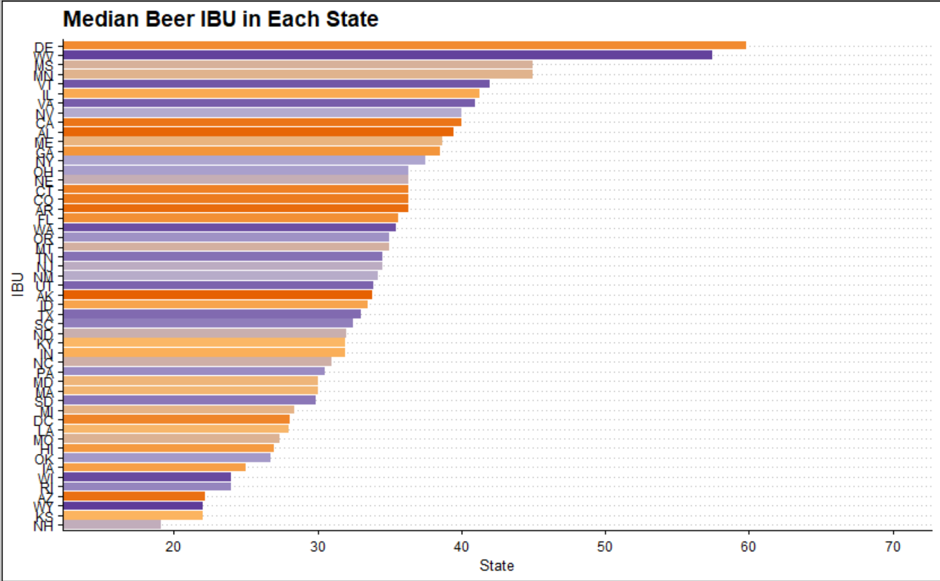
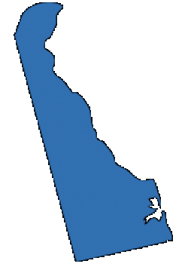
IBU
Delaware Median IBU: 60

Slide 7
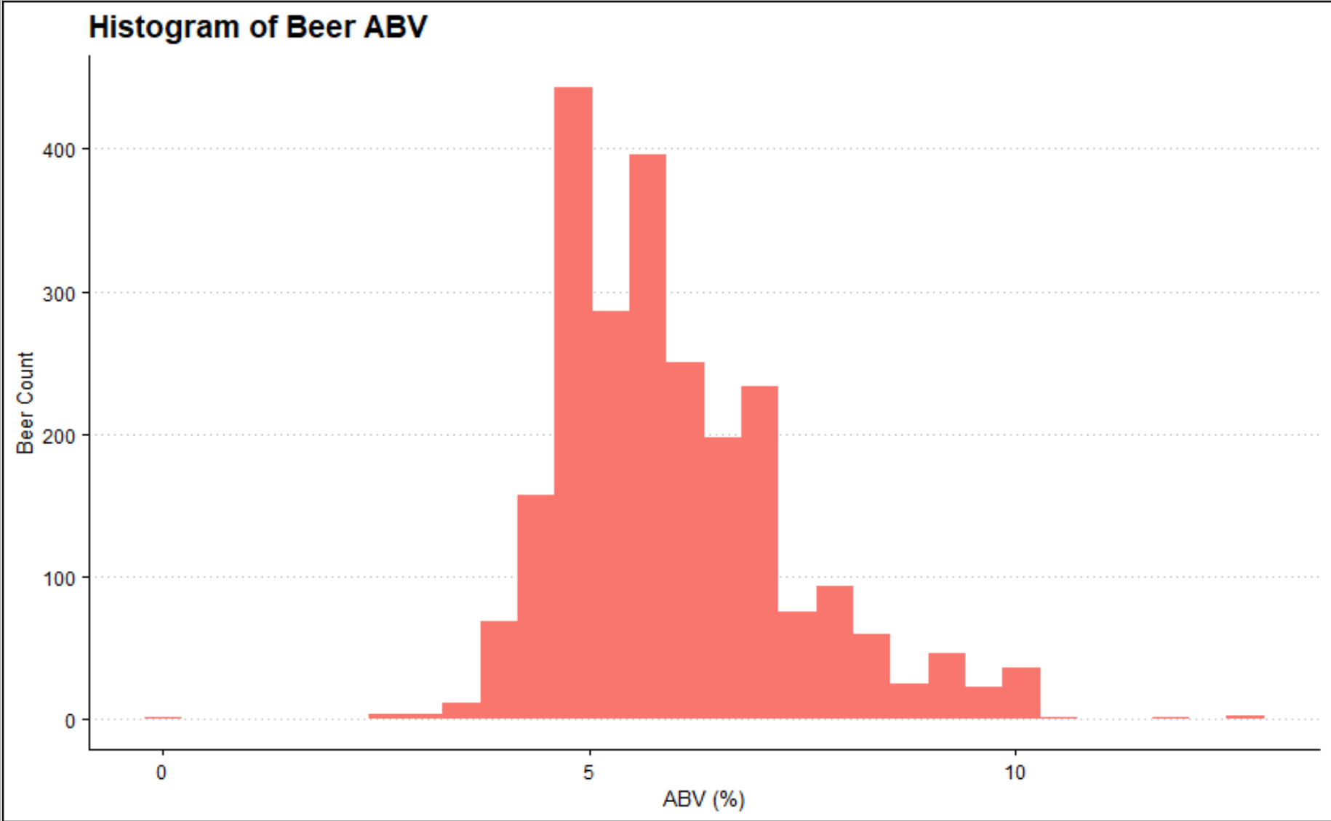
ABV Distribution
Mean: 5.98 ABV
Median: 5.64 ABV

Slide 8
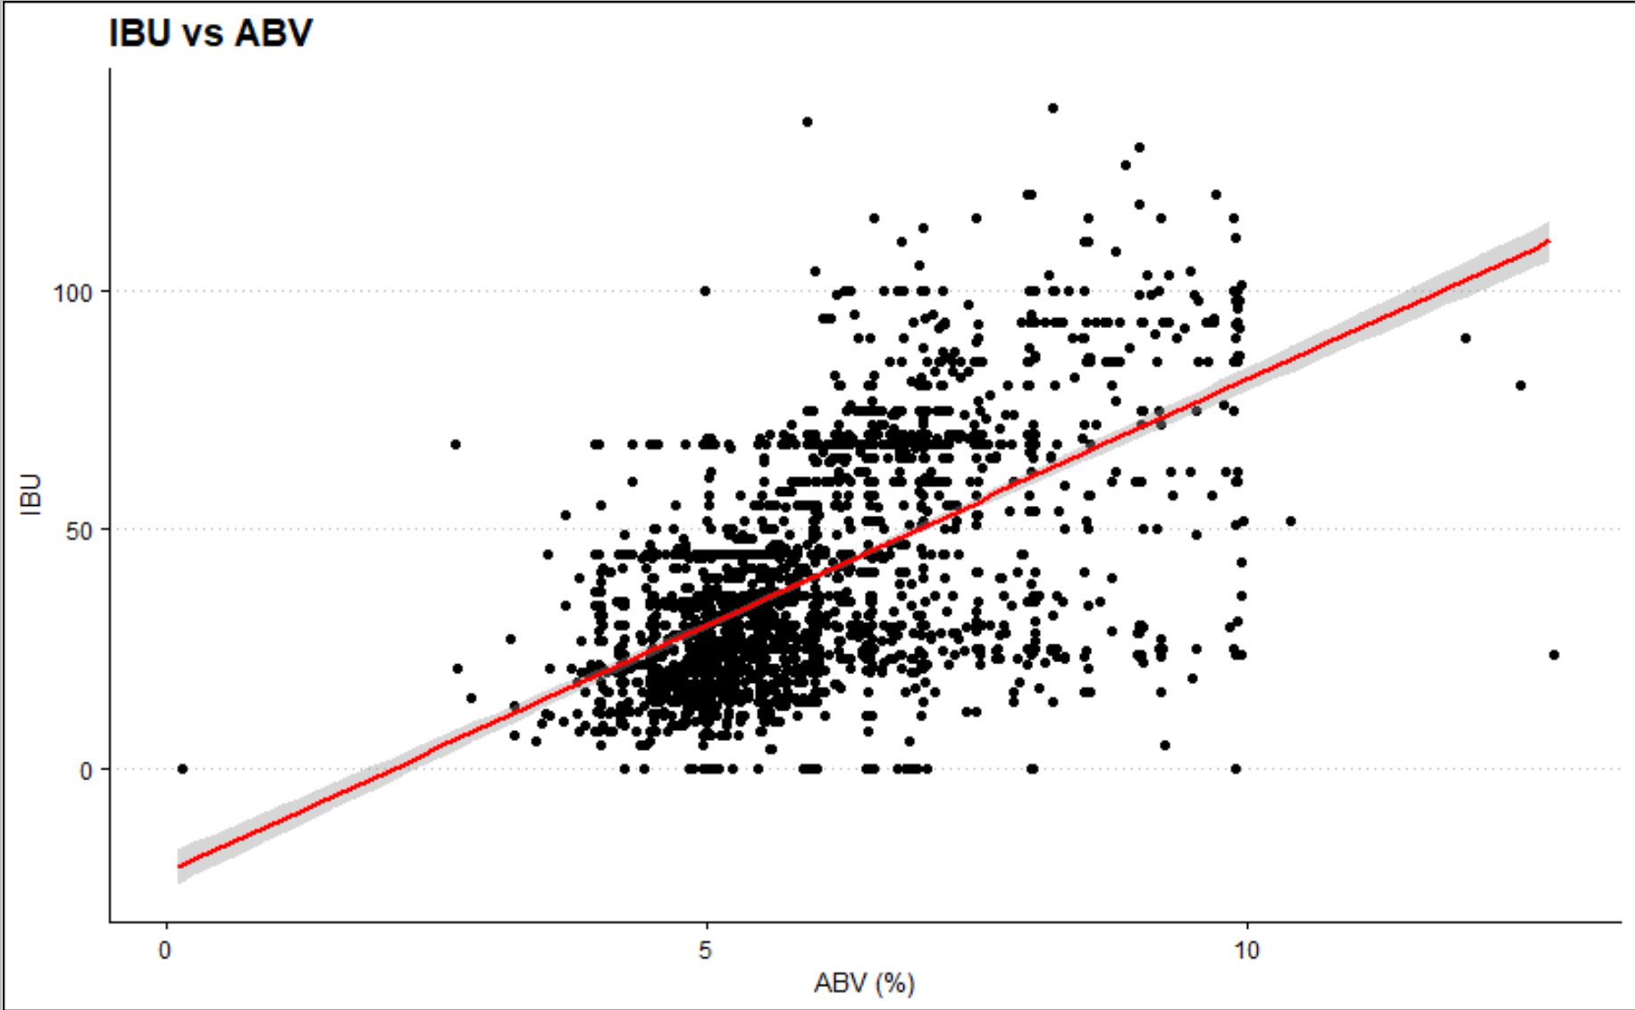
Relationship: ABV vs IBU

Slide 9
Classifying Ales and IPA’s
We wanted to classify beers as IPA’s and Pale Ales based on their ABV and IBU values
To do so we had to tune a knn model to classify our beers.
First, we tuned our k parameter using a internal cross validation model.

Slide 10
Classifying Ales and IPA’s
What color is unknown circle?
K Nearest Neighbors (KNN)
?
k= 3
White
k=7
Red

Slide 12
Classifying Ales and IPA’s

Slide 13
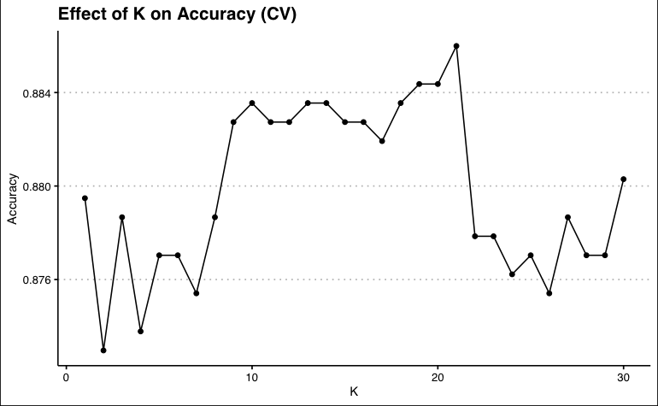
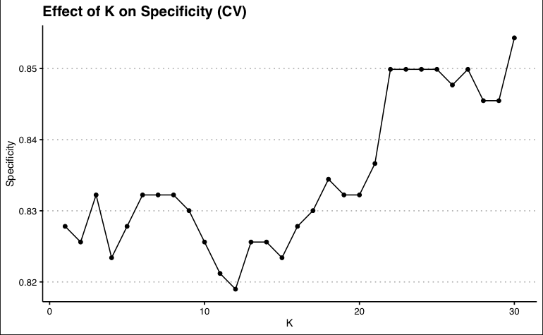
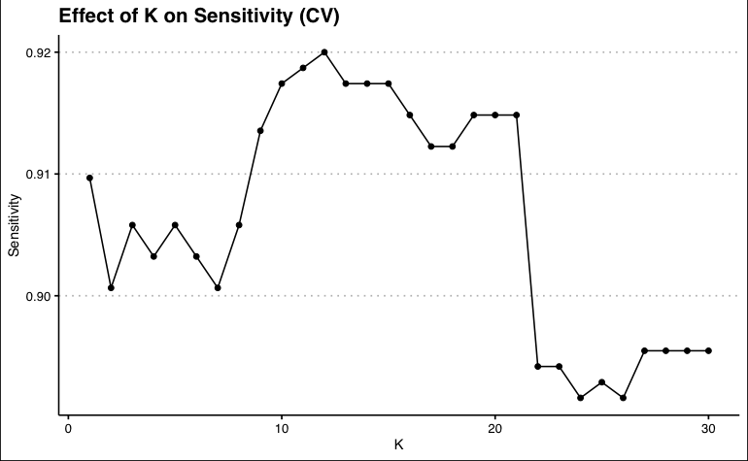
As we can see, the Accuracy and Sensitivity of the knn.cv model drops with significantly with a k > 20
Generally, Specificity increases as k increases
From the CV model we can see that a k of 20 is a great candidate for our model

Slide 14
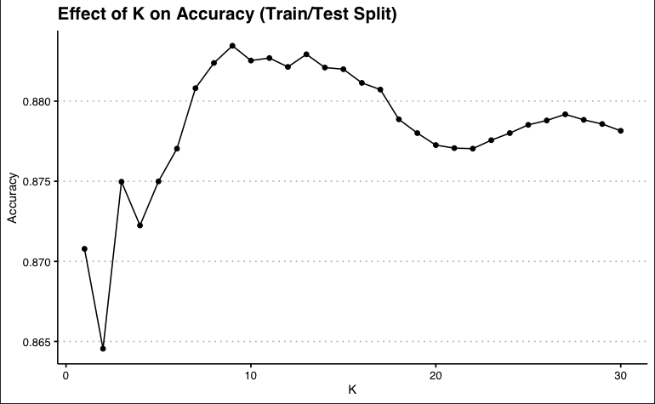
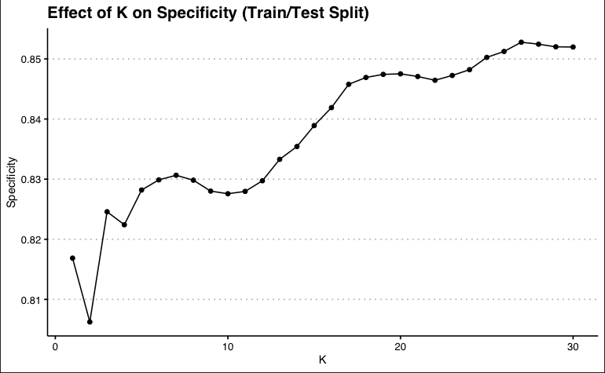
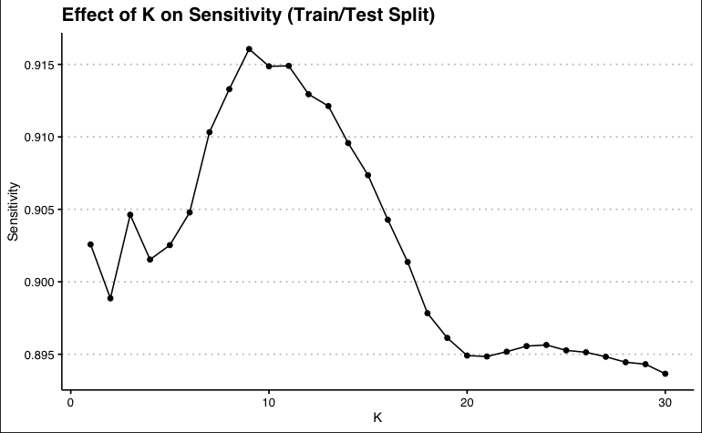
Next we measured performance of our model using an external cross validation model
We see similar behavior for accuracy and specificity, but we see a steep drop off in sensitivity from 10 to 20.
In the end, we choose a k value of 20 as the sensitivity lost between 10 and 20 is approximately only 0.02.

Slide 15
Model Statistics with k = 20
Accuracy | 0.92
Specificity | 0.92
Sensitivity | 0.92
The model was then validated with a data set that was separated from the training set.
Checking the model with our tuned k parameter, we observe good performance with the validation set.

Slide 16
Naive Bayes
Predicting with ABV and IBU
Accuracy | 87%
Specificity | 80%
Sensitivity | 90%
Similar Metrics to KNN

Slide 17

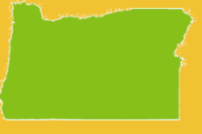

Market Analysis
American IPA
Most Common Style in 39 States
Indiana
Oregon
Washington
Demand for IPA’s

Slide 18
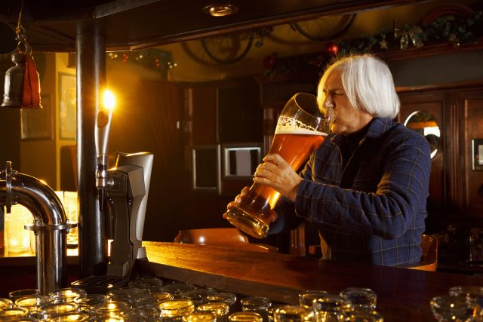
Tavin Weeda
tweeda@smu.edu
Jacob Gipson
gipsonj@smu.edu

